Slide 1
Principles and Foundations of
Health Promotion and Education

Slide 2

What is “health” anyway?
Consider these two questions:
  Define what it means to be “healthy.”
  Who or what is responsible for your health?

Slide 3
Three definitions of “health”
health–“the state of complete mental, physical and social well being not merely the absence of disease or infirmity” (WHO, 1947, p. 1); “a positive concept emphasizing social and personal resources, as well as physical capabilities” (WHO, 1986, p. 5)
health–“a functional state which makes possible the achievement of other goals and activities” (Hanlon, 1974, p. 73)
Health–“a dynamic state or condition that is multidimensional (i.e., physical, emotional, social, intellectual, spiritual, and occupational) a resource for living, and results from a person’s interactions with and adaptation to the environment”
(Joint Committee, 2012, p. 10)

Slide 4
Chapter 1 objectives
Define key terms: health, health education, health promotion, disease prevention, and wellness; public health, community health, population health, and global health
Describe the current status of health education/promotion
Define epidemiology
Explain the means by which health or health status can be measured

Slide 5
Chapter 1 objectives cont’d
List and explain the goals and objectives of health education/promotion
Identify the practice of health education/promotion
Explain key concepts and principles: a) health field concept, b) levels of prevention, c) risk factors, d) health risk reduction, f) chain of infection, g) communicable disease model, h) multicausation disease model, and g) selected principles of health education/promotion: participation, empowerment, advocacy, social media, and cultural competence

Slide 6
Key terms

Slide 7
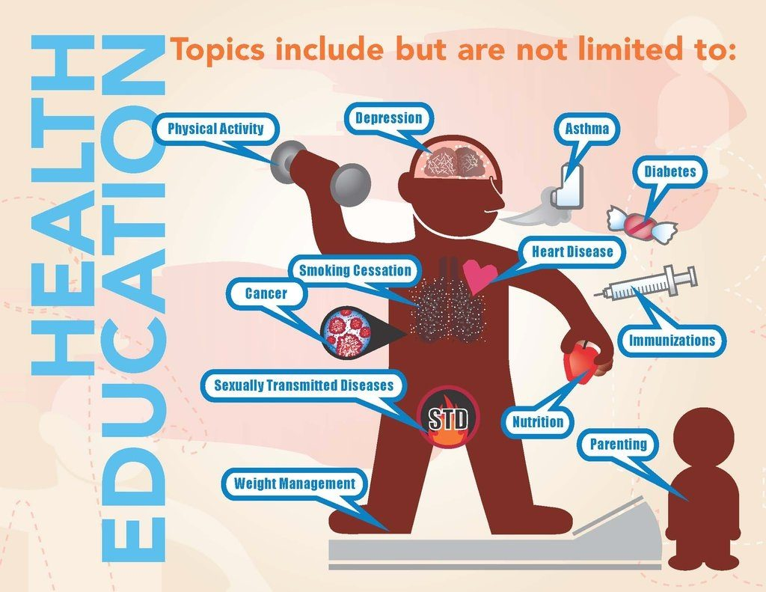
Health Education
Planned learning experiences providing opportunity to acquire knowledge, attitudes, and skills needed to adopt/maintain healthy behaviors.

Slide 8
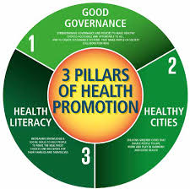
Health Promotion
Planned combination of
  educational,
  political,
  environmental,
  regulatory,
  organizational mechanisms
that support health of individuals, groups, and communities.

Slide 9
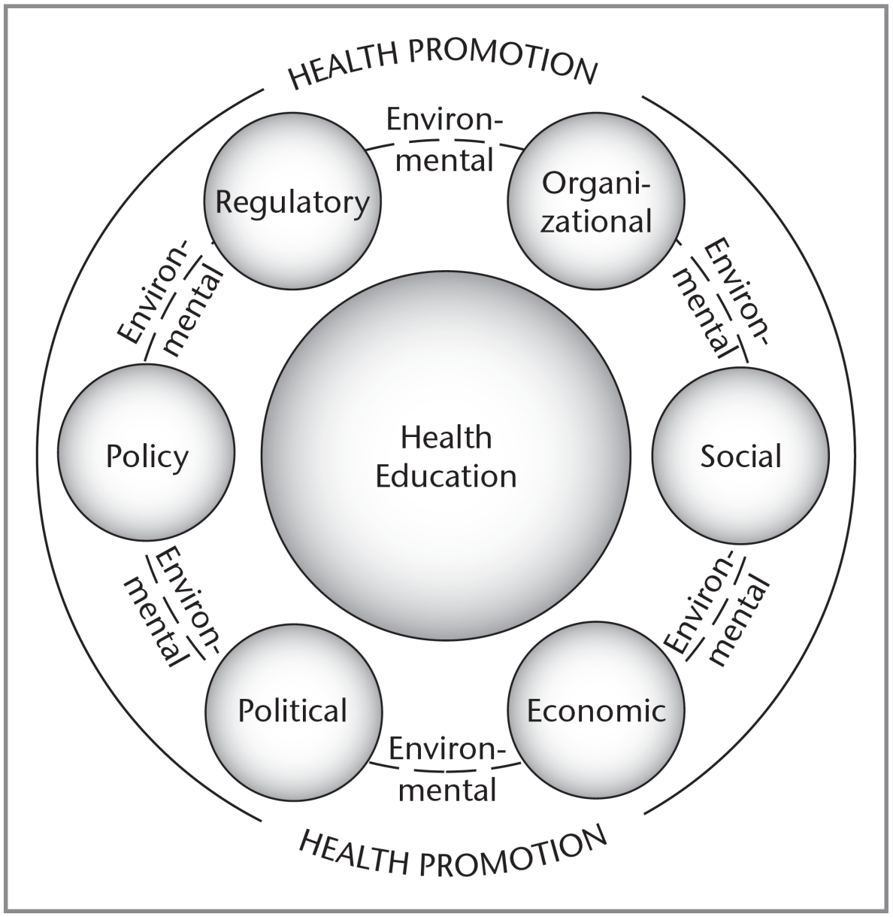
Relationship Between Health Education & Health Promotion
Notes:
Figure 1.1 Relationship between health education and health promotion
Source: From J. F. McKenzie, B. L. Neiger, and R. Thackeray, Planning, Implementing and Evaluating Health Promotion Programs: A Primer. 6th ed., p. 5, Fig 1.1 © 2013. Reproduced by permission of Pearson Education, Inc., Upper Saddle River, NJ.

Slide 10
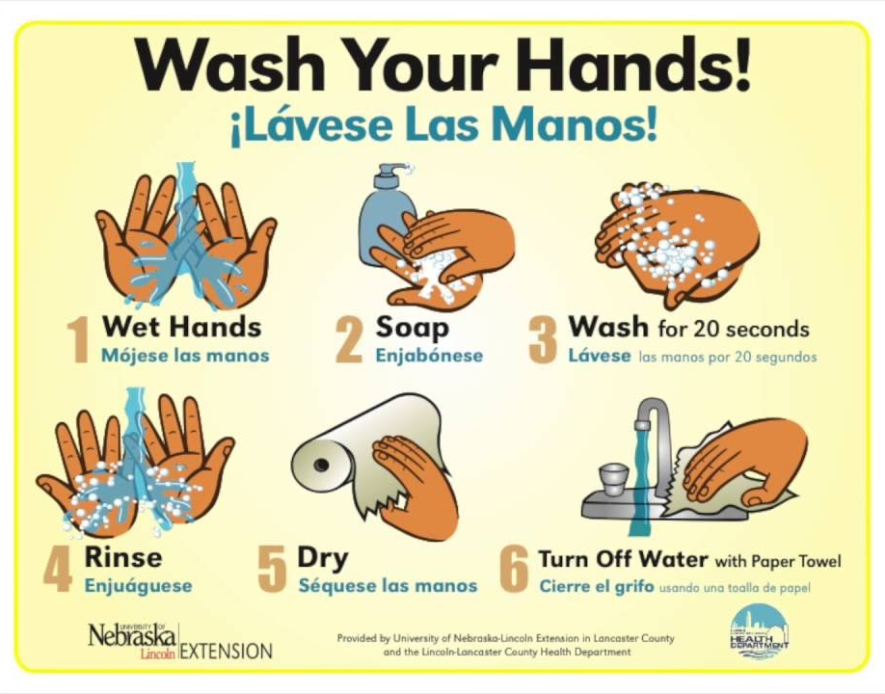
Disease prevention
Reducing risks, alleviating disease to promote, preserve, & restore health, minimize suffering

Slide 11
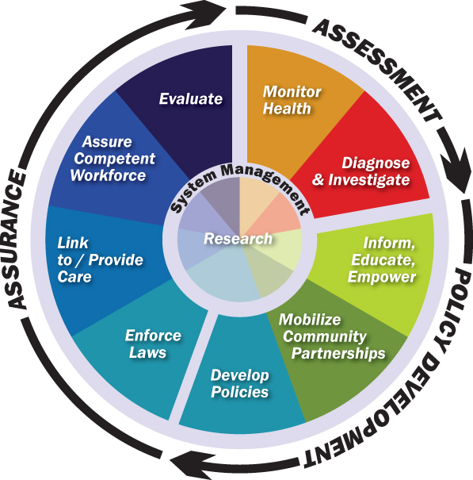
Public Health
Public health: organized effort by society—primarily through public institutions—to improve, promote, protect & restore health of a population through collective action.
Notes:
Includes: health surveillance, health promotion, prevention, infectious disease control, environmental protection, sanitation, emergency preparedness/response, occupational health

Slide 12

Community Health
Health status of a defined group of people, promotion, protection, & preservation of their health
Notes:
Community health: “the health status of a defined group of people and the actions and conditions to promote, protect and preserve their health” (Joint Committee, 2012, p. 15)
Global health: “health problems, issues, and concerns that transcend national boundaries and are beyond the control of individual nations, and are best addressed by cooperative actions and solutions” (Joint Committee, 2012, p. 17)

Slide 13

Global Health
Health problems, issues that cross national boundaries; beyond control of individual nations, must be addressed cooperatively

Slide 14
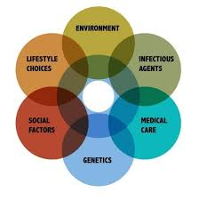
Population Health
Cohesive, integrated, comprehensive approach to healthcare. Considers distribution of health outcomes & determinants influencing access to care/policies and interventions
Notes:
Population health: “a cohesive, integrated, and comprehensive approach to health care that considers the distribution of health outcomes within a population, the health determinants that influence distribution of care, and the policies and interventions that affect and are affected by the determinants” (Nash, Fabius, Skoufalos, Clarke, & Horowitz, 2016, p. 448)
–“an approach to health that focuses on balancing the many aspects, or dimensions, of a person’s life through increasing the adoption of health enhancing conditions and behaviors rather than attempting to minimize conditions of illness” (Joint Committee, 2012, p. 10)

Slide 15
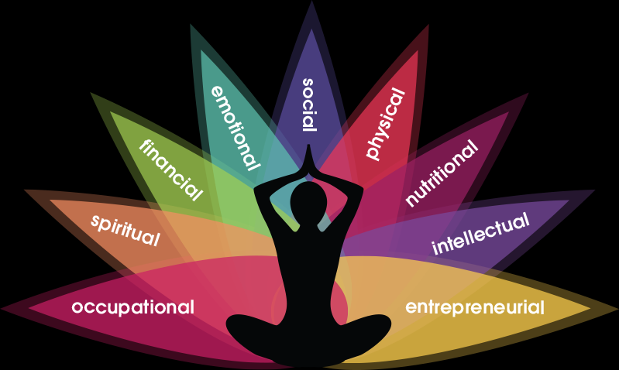
Wellness
Approach to health balancing the multiple dimensions of people’s lives by increasing adoption of health-enhancing conditions/behaviors, not minimizing conditions of illness

Slide 16
Health education and promotion: the profession

Slide 17
The Health Education/Promotion Profession
Visibility of health education/promotion increasing since mid-1970s
Public health efforts late 19th century-1950s: focus on control of infectious diseases
1950s-present, focus on chronic diseases and diseases related to lifestyles
Recognized by mid 1970s that health promotion efforts have great potential for reducing morbidity, saving lives, and reducing costs

Slide 18
The Health Education/Promotion Profession
Introduction of health objectives (1980s) as strategy improves health of the nation
Even though not all objectives would be met, value of the objectives as a means to measure progress was demonstrated
Healthy People 2020 (4th generation), written using measurable objectives, have guided the nation’s health policies since inception

Slide 19
The Health Education/Promotion Profession
Health of people in the United States is better than at any time in the past, but…
…we can do better. Much of current poor health results from four modifiable health risk behaviors:
Lack of physical activity
Poor nutrition
Tobacco use
Excessive alcohol consumption
Means there is a greater need for health education/promotion interventions

Slide 20
The Health Education/Promotion Profession
Field of health education/promotion & prevention has become more defined
Term “health education specialist” favored over “health educator”
“an individual who has met, at a minimum, baccalaureate-level required health education academic preparation qualifications, who serves in a variety of settings, and is able to use appropriate educational strategies and methods to facilitate the development of policies, procedures, interventions, and systems conducive to the health of individuals, groups, and communities”
Notes:
Health education specialist: “an individual who has met, at a minimum, baccalaureate-level required health education academic preparation qualifications, who serves in a variety of settings, and is able to use appropriate educational strategies and methods to facilitate the development of policies, procedures, interventions, and systems conducive to the health of individuals, groups, and communities” (Joint Committee, 2012, p. 18)

Slide 21
Measuring health and health status

Slide 22
Epidemiology
Study of distribution of health-related states or events in specific populations
Application of this study to control health problems
This generates epidemiological data

Slide 23
Classifying magnitude of disease
Endemic: occurs regularly in a population as a matter of course
Epidemic: an unexpectedly large number of cases of an illness, specific health-related behavior, or other health-related event in a population
Pandemic: outbreak over a wide geographical area such as a continent

Slide 24
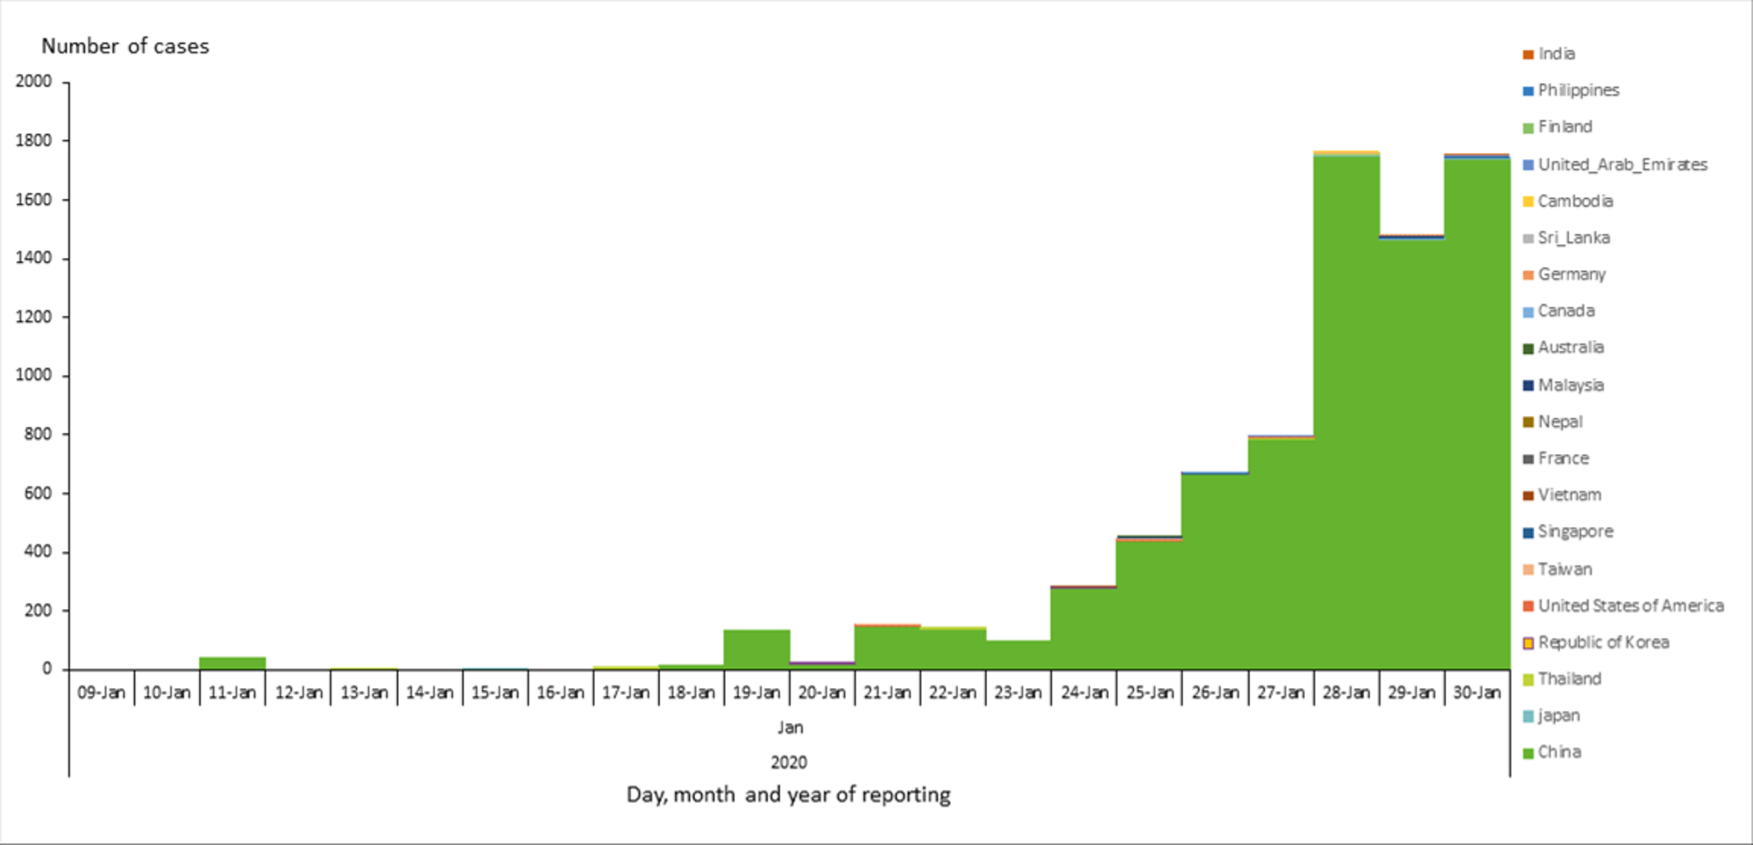
Novel coronavirus epidemiological curve

Slide 25
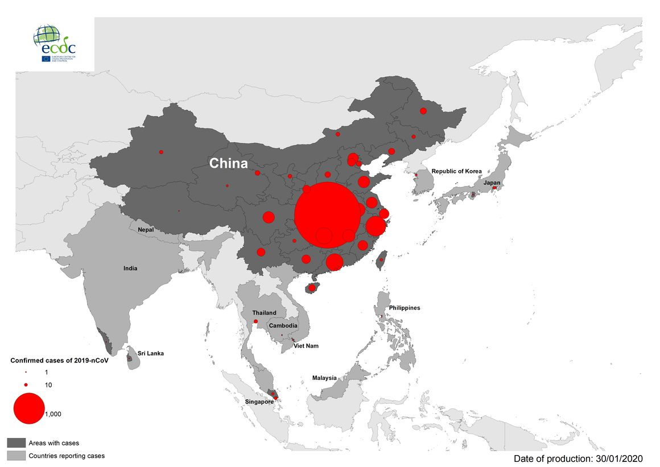
Novel coronavirus case map

Slide 26
Rates
Measure of some event, disease, or condition in relation to a unit of population
Death rate (mortality or fatality rates): most frequently used to measure the seriousness of injury or disease; expressed per 100,000
  Crude rate: expressed for a total population
  Adjusted rate: expressed for a total population, but adjusted for certain characteristics
  Specific rate: rate for a particular population subgroup

Slide 27
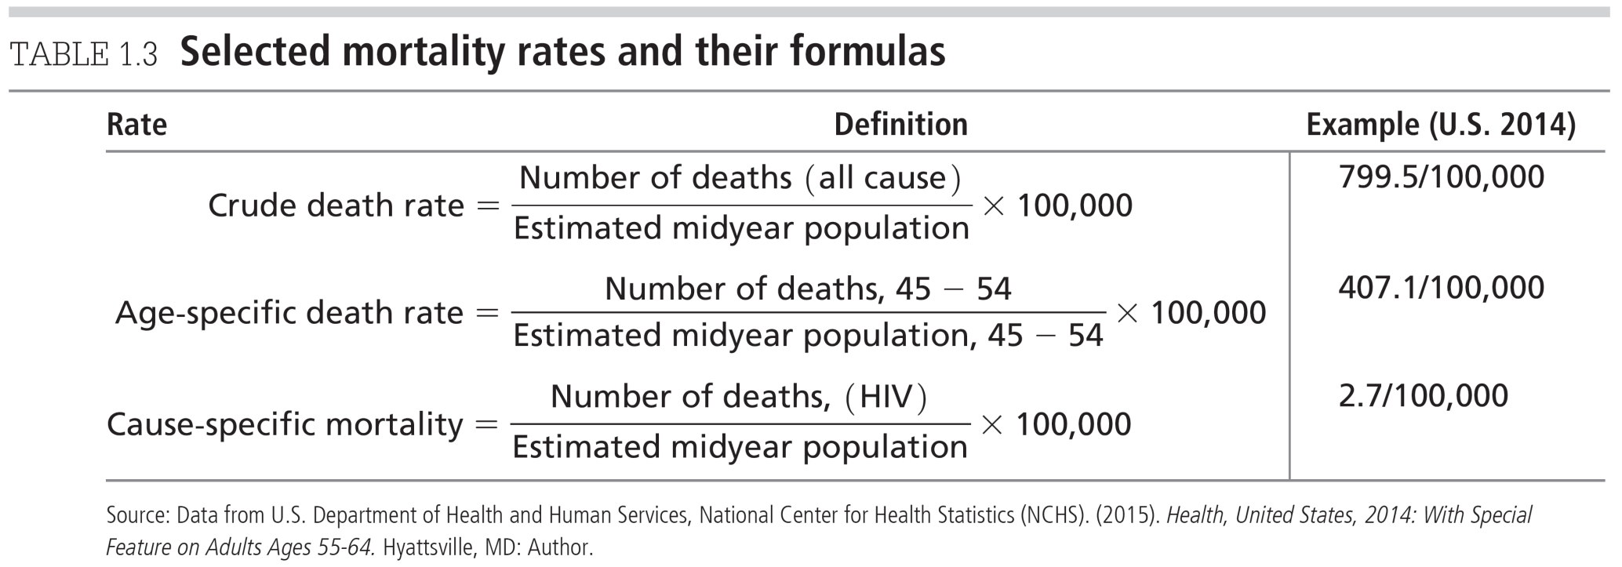
Measuring Health or Health Status

Slide 28
Additional measures of health status
Life expectancy: at birth, at age 65 and 75
Years of potential life lost (YPLL)
Disability-adjusted life years (DALYs)
Health-related quality of life (HRQOL)

Slide 29
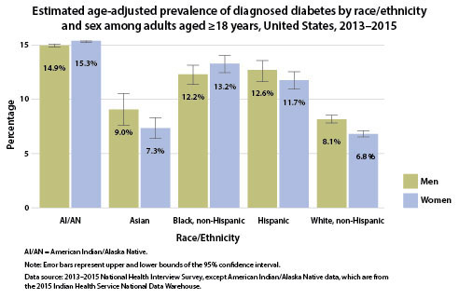
Morbidity rate
Frequency or proportion in which a disease or health condition is found in a group of people.
Often referred to as prevalence

Slide 30
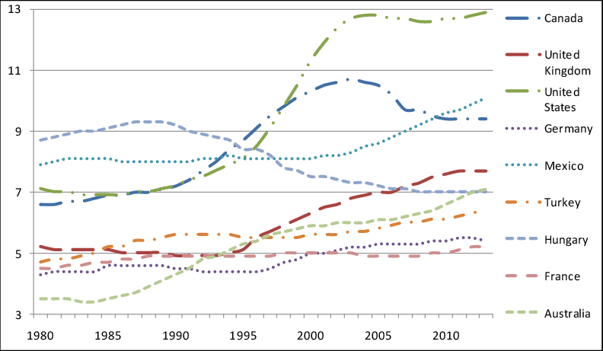
Childhood obesity in OECD countries (percent)

Slide 31
Where do we get this data? One source:
Health surveys
  National Health Interview Survey (NHIS)
  National Health and Nutrition Examination Survey (NHANES)
  National Health Care Surveys (NHCS)
  Behavioral Risk Factor Surveillance System (BRFSS)
  The Youth Risk Behavior Surveillance Survey (YRBSS)
  National College Health Assessment (NCHA)
Notes:
NHIS: telephone survey that asked about health and health behaviors
NHANES: collected data through direct physical examinations, clinical and laboratory testing
NHCS: comprised of six different surveys that are designed to answer key questions about health care providers – a seventh survey to be added
BRFSS: telephone survey of randomly selected adults about risk factors, preventive health practices, access to preventive services and health insurance
YRBSS: monitors six categories of priority health-risk behaviors among youth and young adults
NCHA: collects health data about college students

Slide 32
Using Health Data in Health Education/ Promotion
Why? Major task of health education specialists: to assist the priority population in obtaining, maintaining, and improving their health
Programs should be based on needs of priority population; needs are described using data
May illustrate health disparities: differences in health between populations often caused by two health inequities – lack of access to care and lack of quality care

Slide 33
Why/how we use data:
Primary role of health education specialists: to develop appropriate health education/promotion programs
Evidence: data that can be used to make decisions about planning
Evidence-based practice: when health education specialists practice in such a way that they systematically find, appraise, and use evidence as the basis for decision making when planning health education/promotion programs.

Slide 34
Use evidence at every step of program planning
Assessing the needs of the priority population
Setting goals and objectives
Developing an intervention that considers the peculiarities of the setting
Implementing the intervention
Evaluating the results

Slide 35
What shapes health?

Slide 36
Health field concept
Lalonde, 1974
  Human biology—all aspects of health which are developed in the basic biology of man
  Environment—relates to health external to the human body
  Lifestyle and health behavior—decisions by the individual which affect their health
  Healthcare organization—“quantity, quality, arrangement, nature, and relationship of people and resources in the provision of health care”
  Brought attention to the concept of health promotion and disease prevention, while contributing to a better understanding of what health professionals can do to influence morbidity and mortality of a given population

Slide 37
Determinants of health
Genetics
Individual behavior
Social circumstances
Environmental and physical influences
Health services

Slide 38
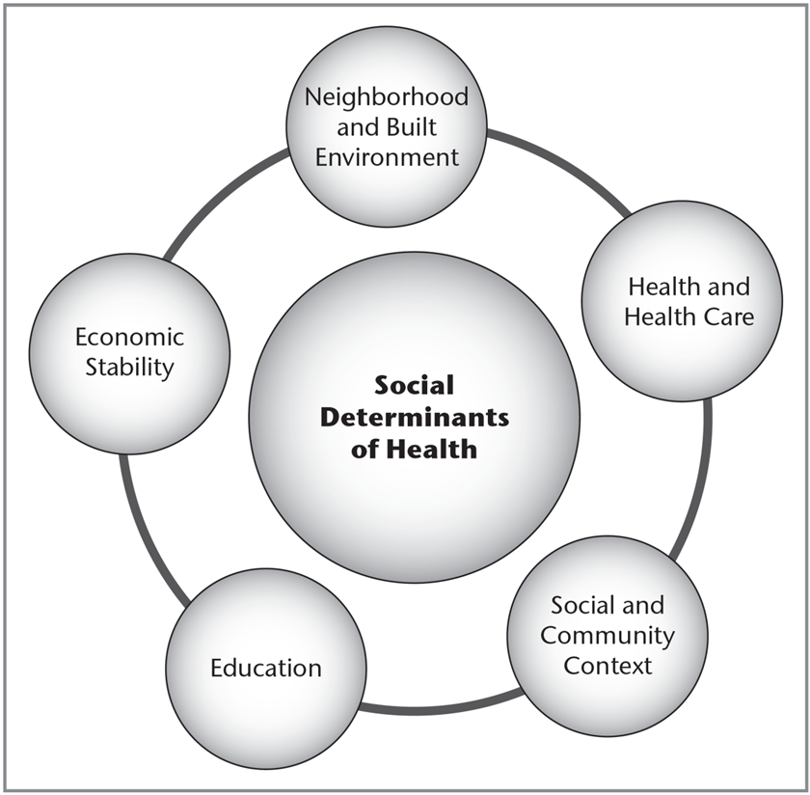
Social determinants of health
Economic stability
Education
Social and community context
Health and health care
Neighborhood and built environment

Slide 39
Why/how do we get sick?

Slide 40
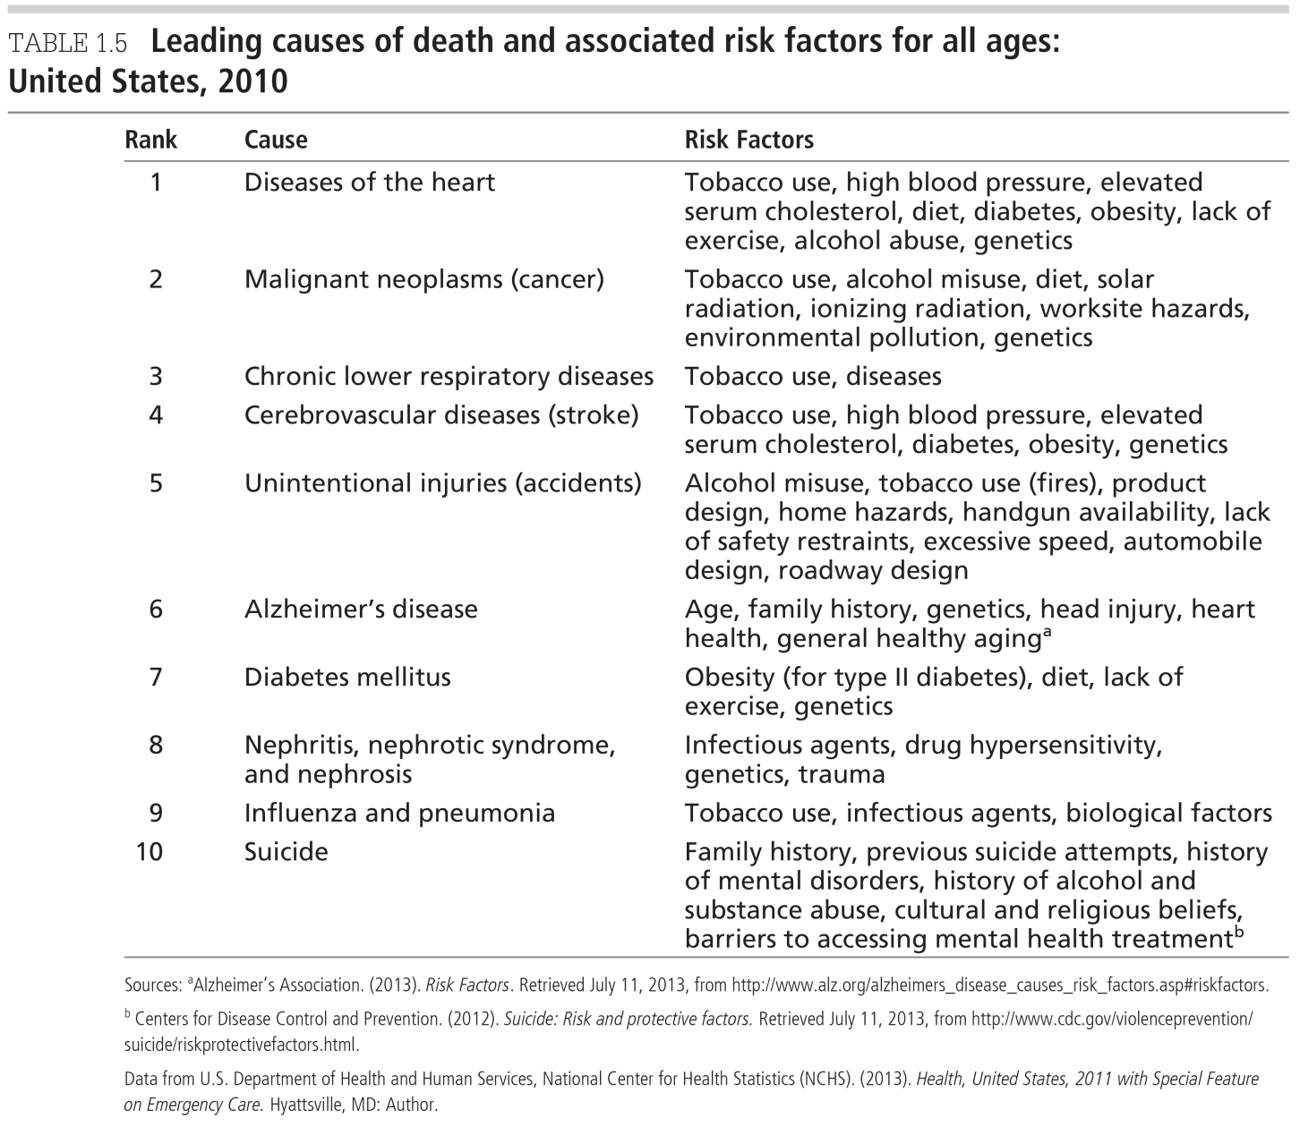
Leading causes of death, risk factors

Slide 41
Risk factors for disease
“any attribute, characteristic or exposure of an individual that increases the likelihood of developing a disease or injury”
Types of risk factors
  Modifiable (changeable or controllable)
  Nonmodifiable (nonchangeable or noncontrollable)
Examples of risk factors for heart disease
  Tobacco use, high BP, elevated cholesterol, diet, diabetes, obesity, lack of exercise, alcohol use, biological factors
Control of modifiable risk factors could prevent 40% of all premature deaths

Slide 42
Health risk reduction
Requires understanding of difference between communicable and noncommunicable disease (or chronic disease)

Slide 43
Communicable and noncommunicable disease
Communicable disease: caused by specific biological agent that can be transmitted from infected person, animal, or inanimate reservoir to susceptible host
Non-communicable disease: illness that cannot be transmitted from infected host to susceptible host. Also called chronic disease

Slide 44
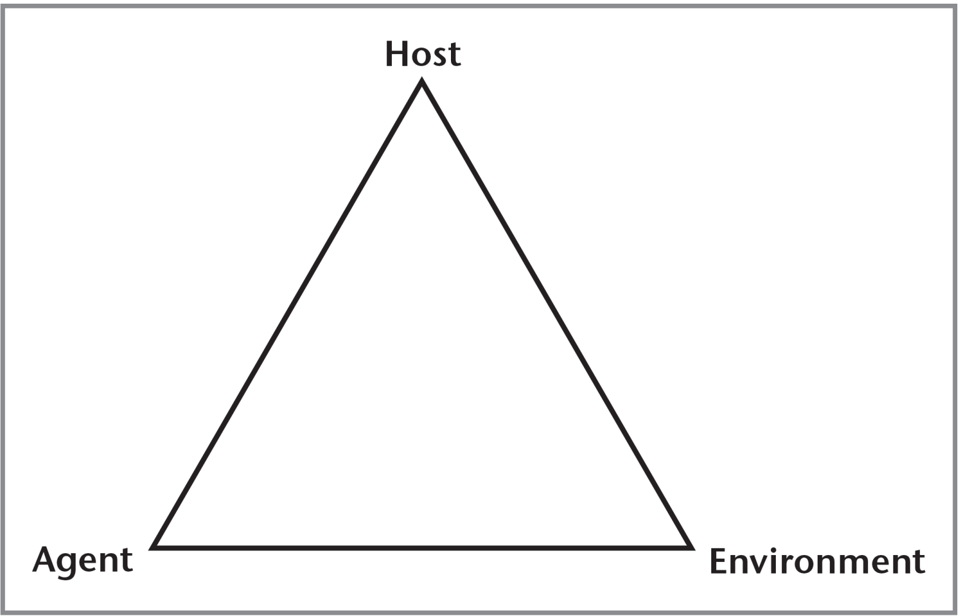
Communicable disease model
Notes:
Figure 1.7 Communicable disease model
Source: From J. F. McKenzie & R. R. Pinger. An Introduction to Community & Public Health, 8th ed. © 2015 Jones and Bartlett Publishers, Sudbury, MA. www.jbpub.com. Reprinted with permission.

Slide 45
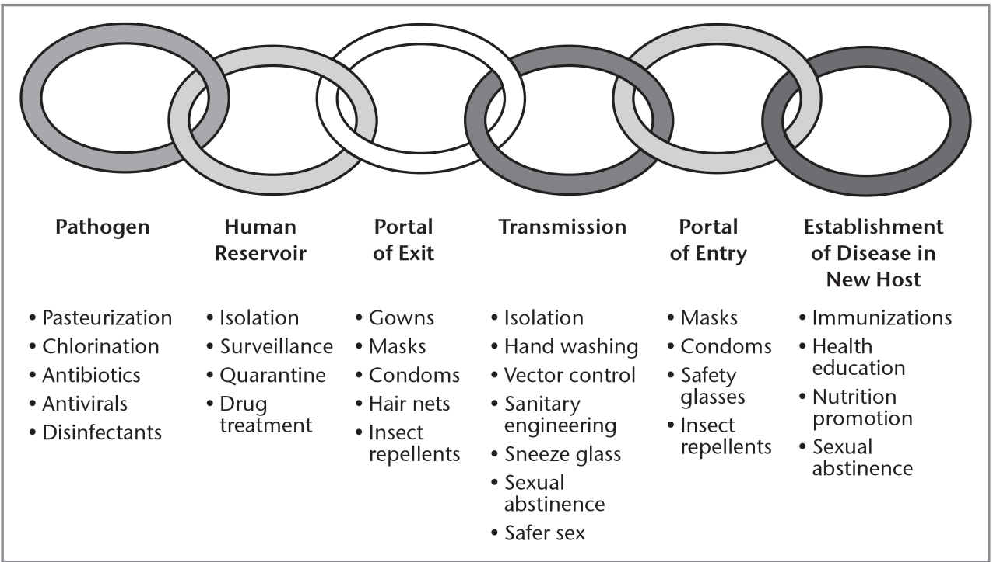
Chain of infection
Communicable disease: caused by specific biological agent that can be transmitted from infected person, animal, or inanimate reservoir to susceptible host
  By breaking chain of infection, individuals can stop spread of communicable disease
Notes:
Figure 1.6, Chain of infection model and strategies for disease prevention and control
Source: From J. F. McKenzie & R. R. Pinger, An Introduction to Community & Public Health. 8th ed. © 2015 Jones and Bartlett Publishers, Sudbury, MA. www.jbpub.com. Reprinted
with permission.

Slide 46
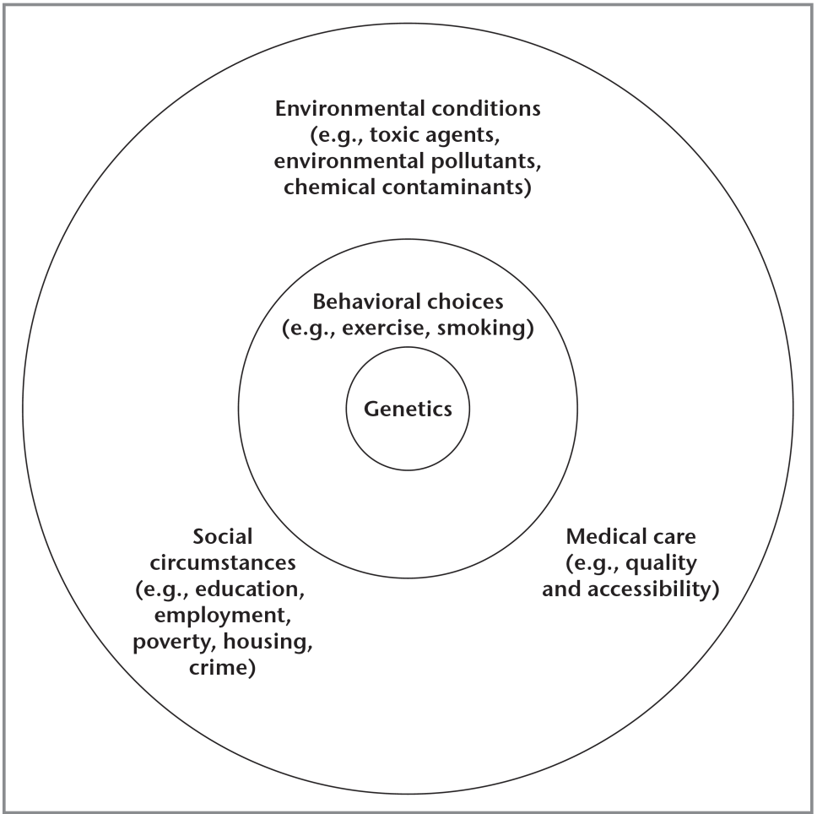
Noncommunicable disease: Multicausation disease model
Notes:
Figure 1.8 Multicausation disease model

Slide 47
Disease prevention

Slide 48
Levels of prevention:
Primary prevention
  prevents onset of illness or injury
Secondary prevention
  early diagnosis and prompt treatment of disease or illness to limit the impact of the disease
Tertiary prevention
  retraining, reeducation, and rehabilitation of an individual who is already disabled or impaired (treatment)

Slide 49
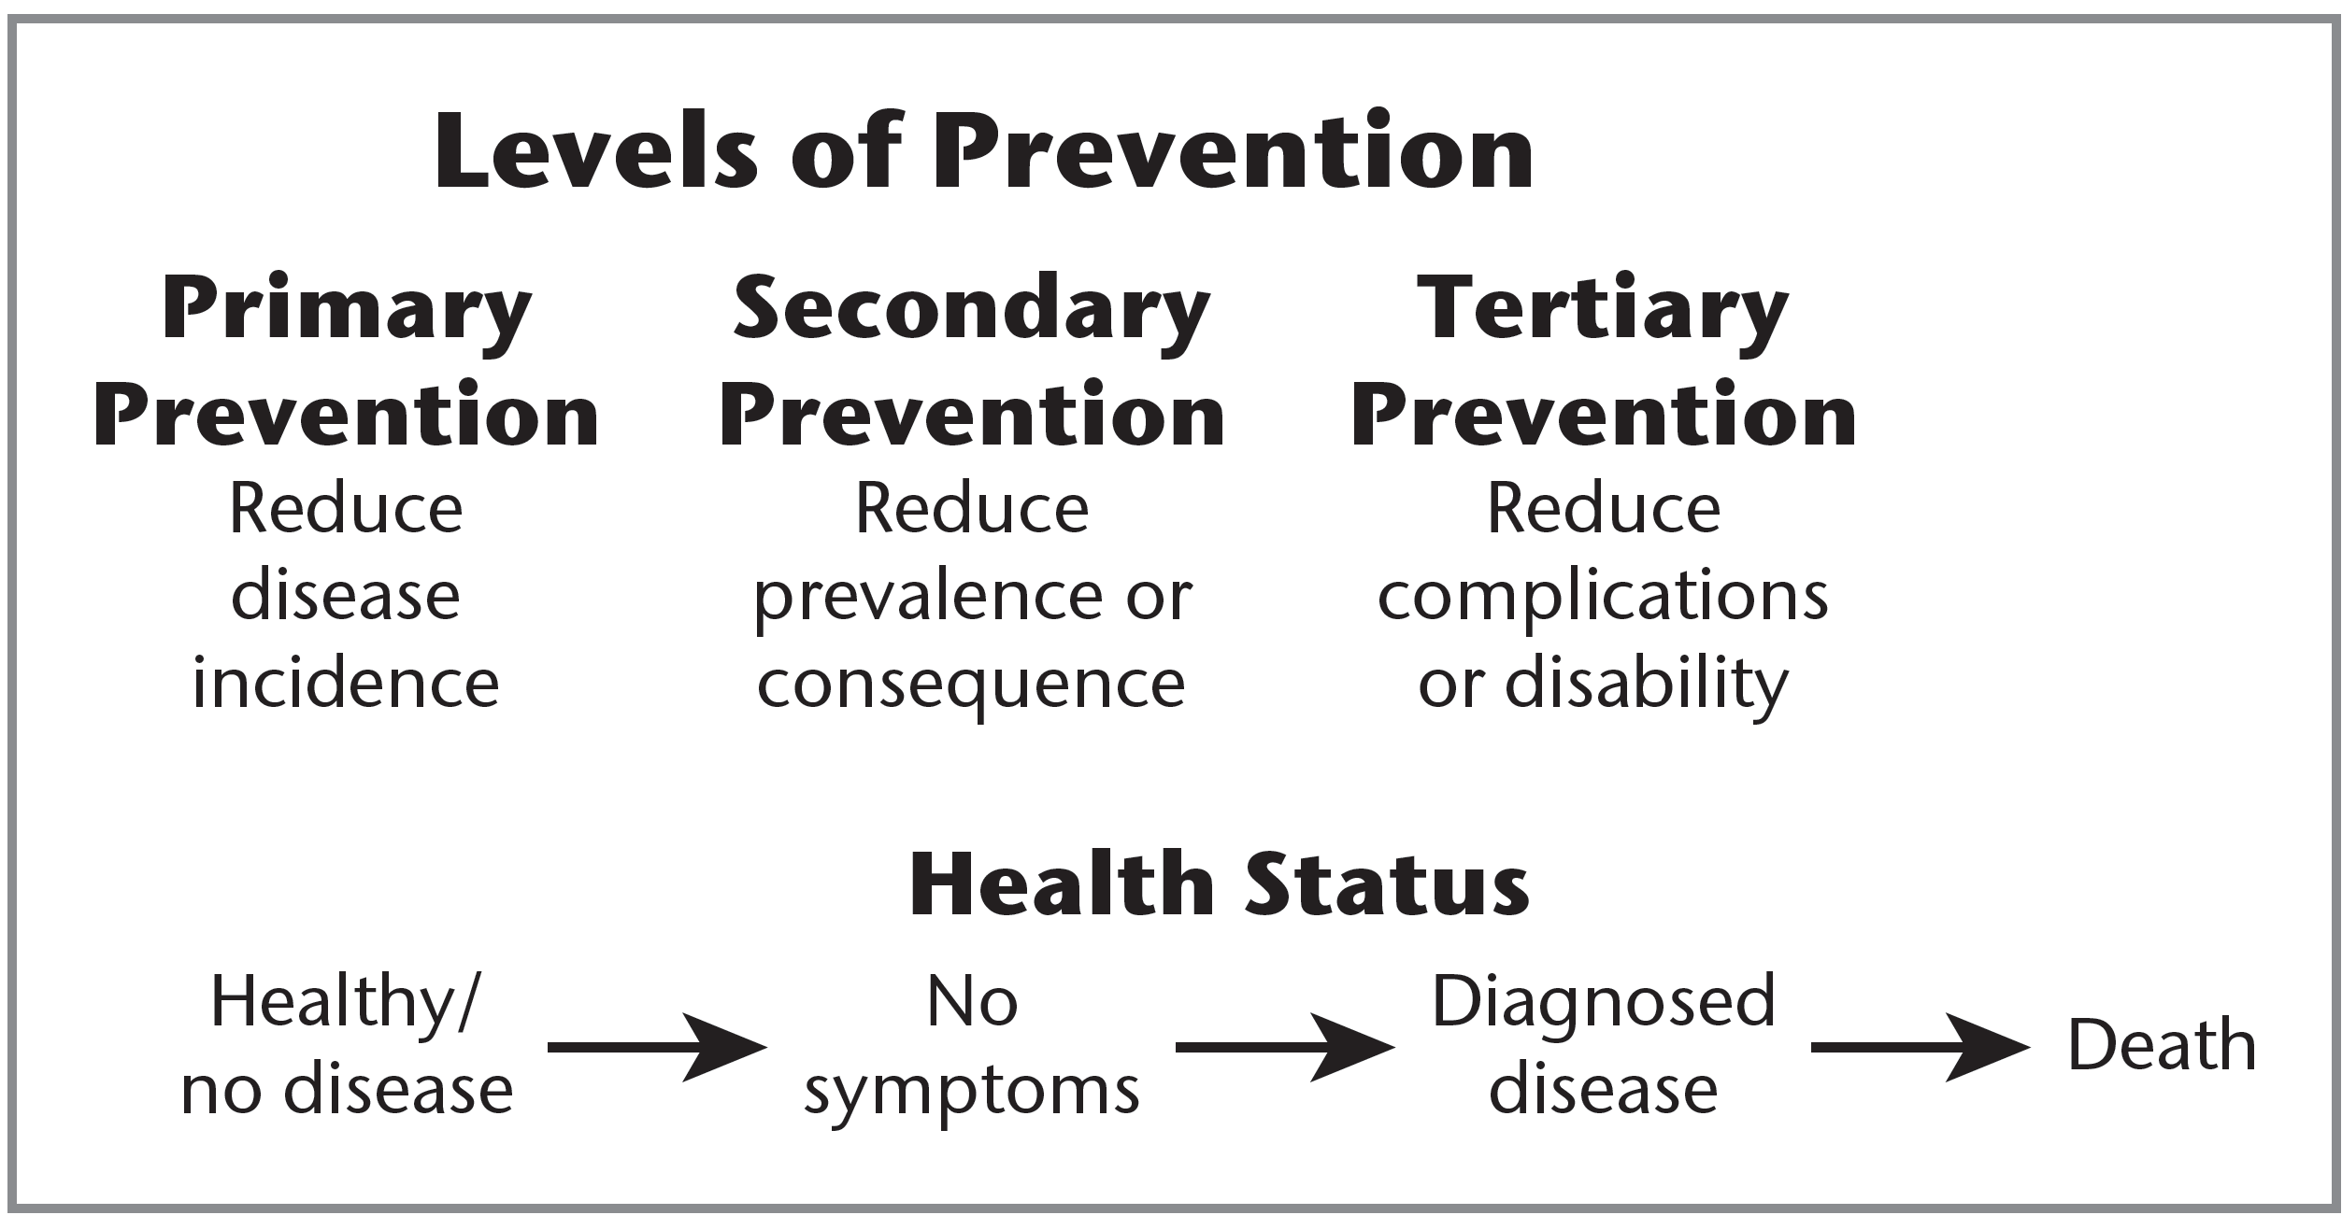
Levels of prevention/Health status
Notes:
Figure 1.4 Levels of Prevention

Slide 50
Limitations of prevention
Biological
Technological
Ethical
Economic

Slide 51
Additional selected principles of health education and promotion
participation – helps minimize ethical issues and ensure ownership
ownership – responsibility for the program/intervention
socio-ecological approach – behavior is influenced by several environmental dimensions
population-based approaches – include policy development, policy advocacy, organizational change, community development, empowerment of individuals, and economic support
advocacy – actions intended to alter public opinion
health advocacy – actions intended to bring about change related to health goal, program, interest, or population
empowerment – “social action process for people to gain mastery over their lives and the lives of their communities” (Minkler, Wallerstein, & Wilson, 2008, p. 294)

Slide 52
Cultural competence
Health educators and promotors have to adopt values, principles, behaviors, attitudes, and policies that enable them to work effectively across racial, ethnic and linguistically diverse populations

